Slide 1
PROJECT TITTLE
GEOSPATIAL ANALYSIS ON WATER RESOURCE MANAGEMENT ON SURFACE WATER IN DURHAM;CANADA

Slide 2
OBJECTIVES OF THE PROJECT
To find out the water resource watersheds maps/ satellite images in Durham.
To find out the policies and regulation governing water resources in Canada

Slide 3
INTRODUCTION.
. Geographical Information System tools have been used to solve geographical related problems.They have been also used in predicting future change on earth land use systems or on climate change,Monitor performance and also provide spatial data as required.
Similarlly by use of GIS one can get to know the actual real time and real weather of a place,therefore showing how these real time and weather can affect people activities.Therefore this function helps the same people take necessary step to fit to the change and the time.

Slide 4
INTRODUCTION
Geospatial data analysis brings together ,evaluates and shows the geographical Information System data and images.The analysed spatial data derived is used to get satllites images and geography photos on the earth.
Simillary,the geospatial data used uses all kinds of media platforms to come up with a clear data and easening the right trend on resources.
On earth, there are more than 326 million trillion particles of water. As it is known, less than 3% of this water is safe and fresh for use. Almost two-thirds of it is in ice caps form. Water is significantly used to produce hydropower through energy harnessing.

Slide 5
INTRODUCTION
Water is termed as a renewables source of energy compared to others. In our daily activities, it is very impossible to do without it. Talk of washing, toilet usage drinking we need water for survival.
In Canada, there is the National Hydro Network (NHN) that gives geospatial data digitally explaining water features like rivers lakes, and dams.

Slide 6
INTRODUCTION
Because of the nature of spatial data required GIS has been used in modeling water resources.
Geospatial analysis has recently risen in water resources data in measuring and observing changes occurring on water resources in general.
Using the GIS data, geospatial analysis information on water resources can be used to help people take specific steps before certain calamities like drought which is done through prediction and continuous monitoring.
Geospatial data analysis taken at a resolution of 8km shows that 63.5% of people in Africa and other continents rely on resources of water that are at the same time available and limited.

Slide 7
INTRODUCTION
For instance, in Durham 2018 its Canadian government ensured that every individual is entitled to clean and safe water for drinking.
By so doing the government was so sure that this will reduce health issues related to dirty water. Intern this would strengthen its economy and creating opportunities.
The government is doing so by imposing policies and legislations to govern water resource management.

Slide 8
STUDY AREA
The study took place in region of Durham which lies on 53.542613N, 113.494290W Coordinates.This is a regional municipality in the south of Ontario in Canada.It is east of Toronto and the New York municipality. Durham makes the eastern endpoint of Greater Toronto. This is a fast-growing region with almost 690000 population and it is viewed that it will reach 1 million people by 2031 showing that it is growing at a very high rate population-wise.
To the south lies Lake Ontario, East lake Scugog and lastly lake Simcoe to the North.
People in this region do farming as indicated by plenty of farmlands.

Slide 9
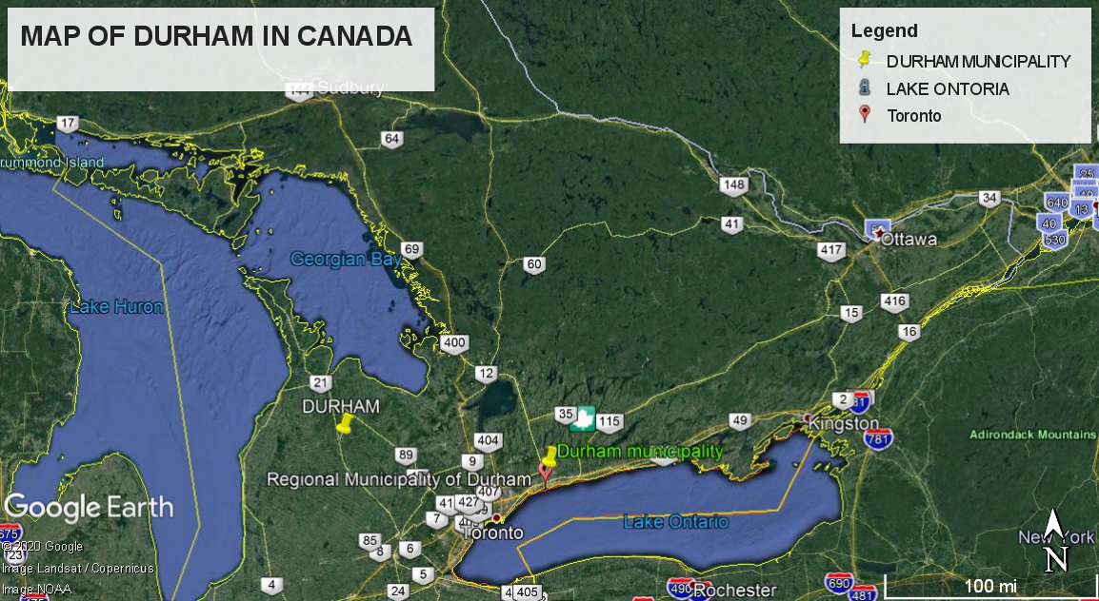
STUDY AREA.

Slide 10
TYPES OF DATA
In every GIS, there are certain types of data. These include raster data and vector data as outlined by most GIS books.These data types are.
.Raster data represents features in square cells with several values intact to each cell. Below is an example of raster data with low and high resolutions. Each raster grid format contains a huge amount of information.
EXAMPLE OF RASTER DATA

Slide 11
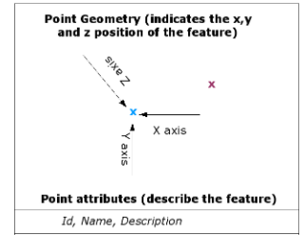
TYPES OF DATA
Vector data is made of points (x and y-coordinates), lines, and area polygons. Point data represents nonadjacent features and data points
. Examples of these features include schools and points of interest in geographical location. These feature has only one dimension and the only length can be measured. These features have start and endpoints.
Example of vector data.

Slide 12
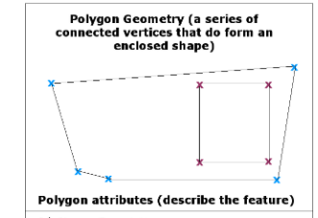
TYPES OF DATA
The x in blue for example can be a mango tree out the offices
The x in purple could be a CCTV post on the company entry
Here is a vector polygon data example

Slide 13
SOURCES OF THE DATA USED IN THE PROJECT.
Canadian Geographical Names (C.G.N)-The Canadian Geographical Names Data Base (C.G.N.D.B) is the national authorized database in Canada by the geographical names.
Its aim is to names places and attributes that have been authorized by the Geographical Names Board of Canada (GNBC).
GeoGratis- GeoGratis is an app like system given by the Earth Sciences Sector (ESS) of Natural Resources Canada (NRCan) that geospatial data for free and its limitless through the Web browser. The data is important whether when one needs a map to present a geographically, also it is required by an expert that requires vector data overlay

Slide 14
SOURCES OF THE DATA USED
Geobase-GEOBASE is a database related in literature research which covered large geoscience international review .
Some of the geoscience literature covered in Geobase are;science on earth,study od rocks(geology),geography on human,Environmental sciences,study of aceans and more others.
The site covers large scale information on of resource planning and their management. These are covered on the many abstracts covered in Geobase.

Slide 15
FLOW CHART OF THE SPATIAL DATA MINING PROCESS
DATA MINING FLOW CHART..
DATA STORE
CLEANED DATA
TRANSFORMATION
SELECTED DATA
EXTRACTED INFORMATION
PROCESSING
INFORMATION INTERPRETATION
CLEANING
SELECTION

Slide 16
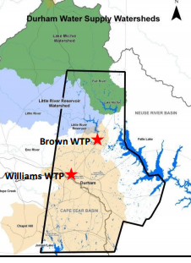
MAPS IN THE STUDY CASE
1.WATERSHED MAP

Slide 17
MAPS IN THE STUDY CASE

Slide 18
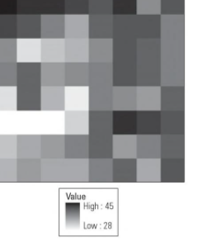
MAPS IN THE STUDY CASE.
3.EXAMPLE OF RASTER DATA IMAGE.

Slide 19
APPLICATION OF GIS SKILLS ACQUIRED IN OTHER ENVIRONMENTAL PROJECTS
Gis skill can be applied to diverse fields.in environment ,apart from water resources they can be applied in other natural resources like wildlife,forestry and geology.
In forestry,the skills acquired can be used in marking boundary of two distinct forests cover.
In wildlife GIS skill can be used to solve human-wildlife conflict.This is done by monitoring the most aggressive wildlife by fixing them with GPS (Geographical position System) fitted collars to study their movement.

Slide 20
APPLICATION OF GIS SKILLS ACQUIRED IN OTHER ENVIRONMENTAL PROJECTS
In agriculture,GIS skill can be applied to map the land use system.This is done when different land use systems are overlayed .The GIS technology is capable of showing the different between several land use systems.
In geology,the skill can be used to show the different types of soils and rocks present in a certain topography.The different is brought by color effect application.For instance one soil types can be distinct by color brown,red or even grey.This is done by a app like system called QGIS or one can use other app found in computers.

Slide 21
CONCLUSION.
In this work geospartial data analysis on water resource especially on surface water has being given on a light note.From the projects,some data mining process have being discussed so as to know what really happens to a raw data once collected geographically and how it can be changed to useful information.
The information derived from the raw data is the one used to tell what will happen especially on water resource in future.Therefore the use of GIS and geospatial data is unavoidable in any water resource management case.

Slide 22
CONCLUSION
On watershed spatial distribution results, it is of importance since this,can enable monitoring on the uses of the surface water in Canada and other coutries in large,therefore the geospatial data at any given natural resource is of important.
Considering the polies applied to water resources management in Canada,enhances the government to provide safe for health water to its people.Also these polies have given the government easy time to manage and monitor the trends of water usage in Canada.

